Slide 1

Web AppBuilder for ArcGIS: Knowing Your Options - 2019 GIS/LIS

Slide 2
What is the Web Appbuilder for ArcGIS?
An ArcGIS Framework that allows one to create HTML/JavaScript Apps that run on desktops, tablets, and smartphones
The software allows you create applications without any coding……However you can create even cooler apps if you know how to code with the Developers edition
Has built in/ready-to-use widgets and themes to choose from
Allows one to deploy a WAB app on ArcGIS Online or on web server
Built in responsive design (display adjust based on device used)
Requires ArcGIS Online or Portal for ArcGIS
The framework is integrated with WebMaps

Slide 3
2 Options to Work With Web AppBuilder
Within ArcGIS Online or Portal for ArcGIS
Framework embedded in the web site
Activate in AGOL and Portal from Multiple places
Developer Edition
Separate download and installed locally
Sign in with ArcGIS Online or Portal for ArcGIS credentials
Support for custom widgets and themes
System requirements
https://developers.arcgis.com/web-appbuilder/guide/xt-system-requirements.htm

Slide 4

How Can It Help You Create Applications?
I will attempt to show you

Slide 5

But First…….You need to know the fundamental parts (If you don’t already know them)

Slide 6
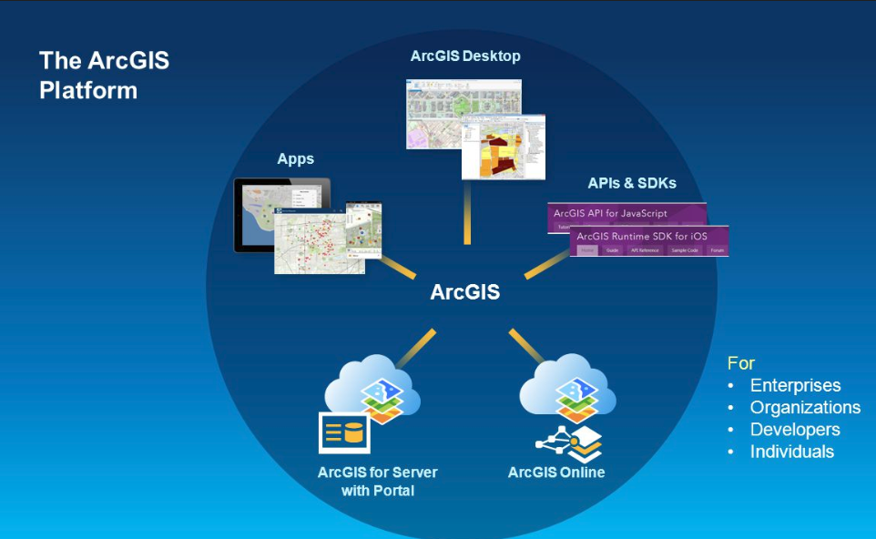
The Platform (image by Esri)

Slide 7
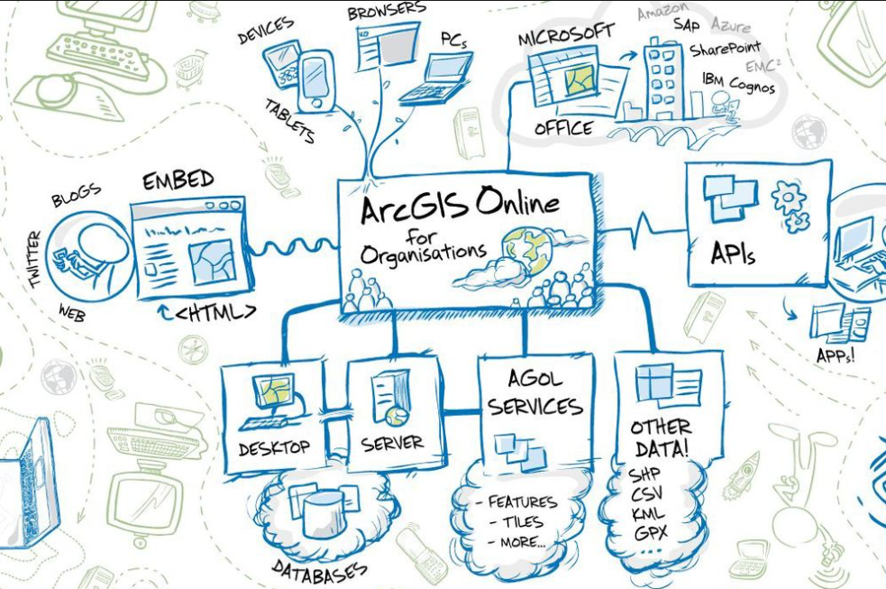
The Platform (image by Roket Science)

Slide 8
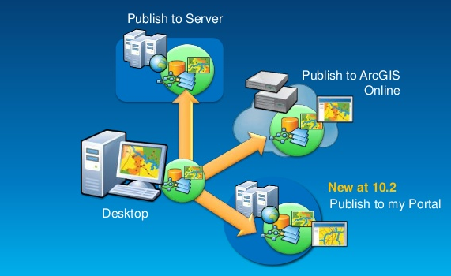
Publish GIS Data

Slide 9
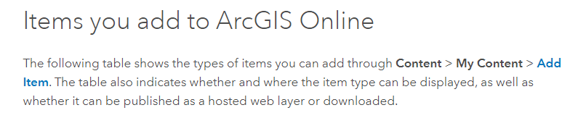
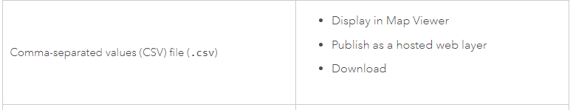

No Desktop Software…Manually add Data
Plus many, many more….see link below
https://doc.arcgis.com/en/arcgis-online/reference/supported-items.htm

Slide 10
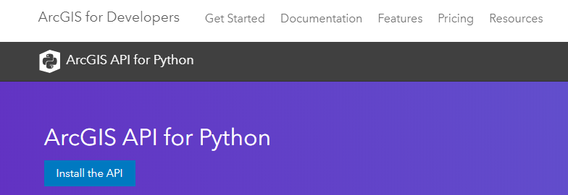

Automate data upload and/or updates
ArcGIS Desktop (Python 2.x) Pro (Python 3.x)

Slide 11
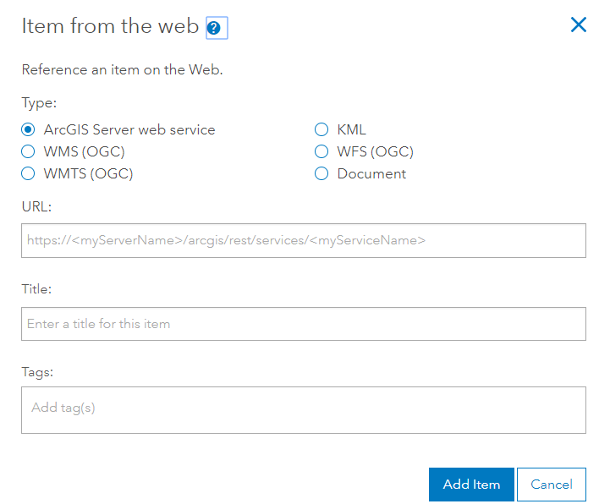
Consume services - Hosted services (layers published to AGOL) - Types: Feature layers, Tile layers, Vector tile layers, scene layers (3d), and more - Consumed services - services that are stored in ArcGIS for Server REST directory or other compatible directory that are accessed by AGOL or Portal and stored as a AGOL/Portal configuration

Slide 12
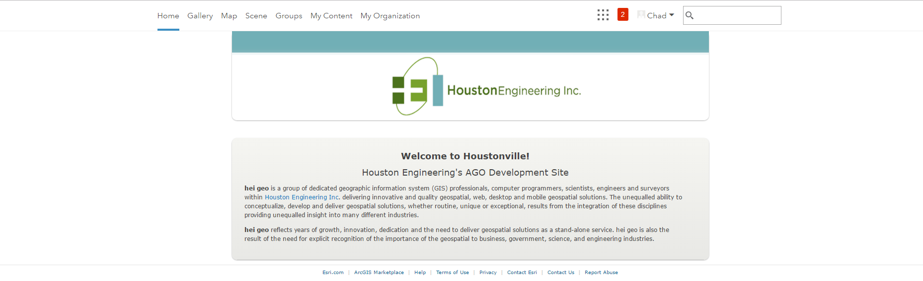
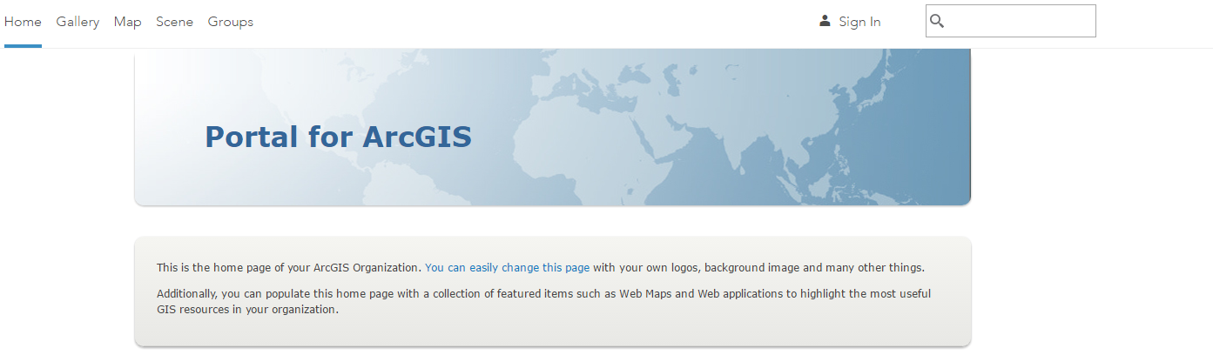
Create a web Map – Portal or ArcGIS Online

Slide 13
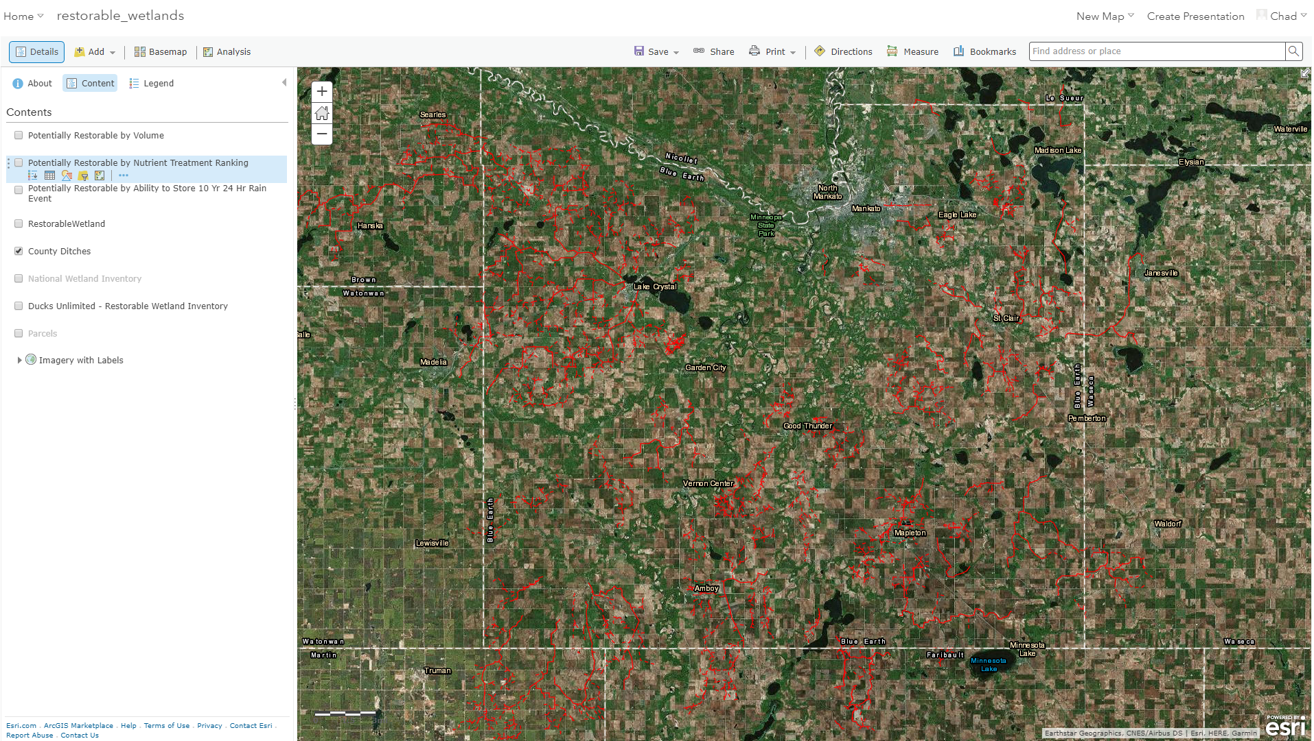
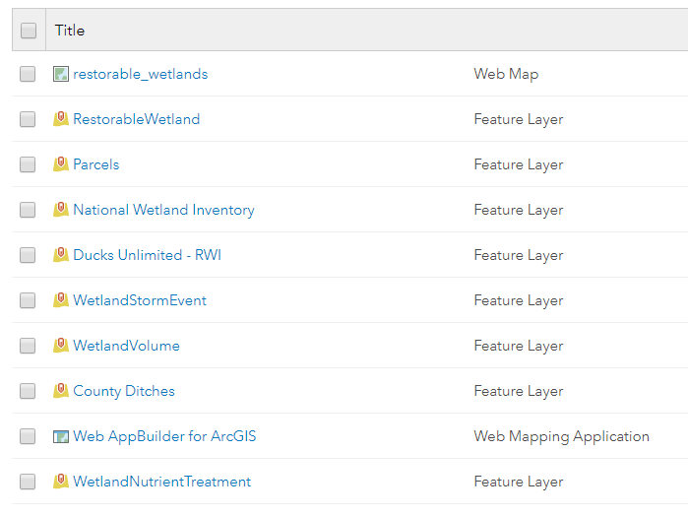
Configure, Share, and Save the web map

Slide 14
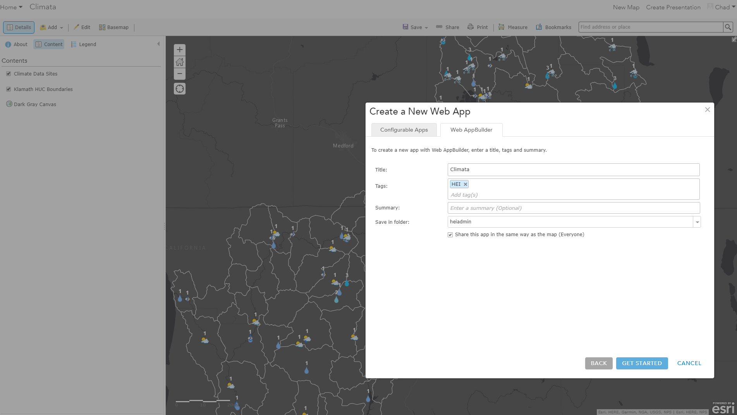
Create a Web AppBuilder App from your web map in Portal for ArcGIS or ArcGIS Online – Same Process!

Slide 15
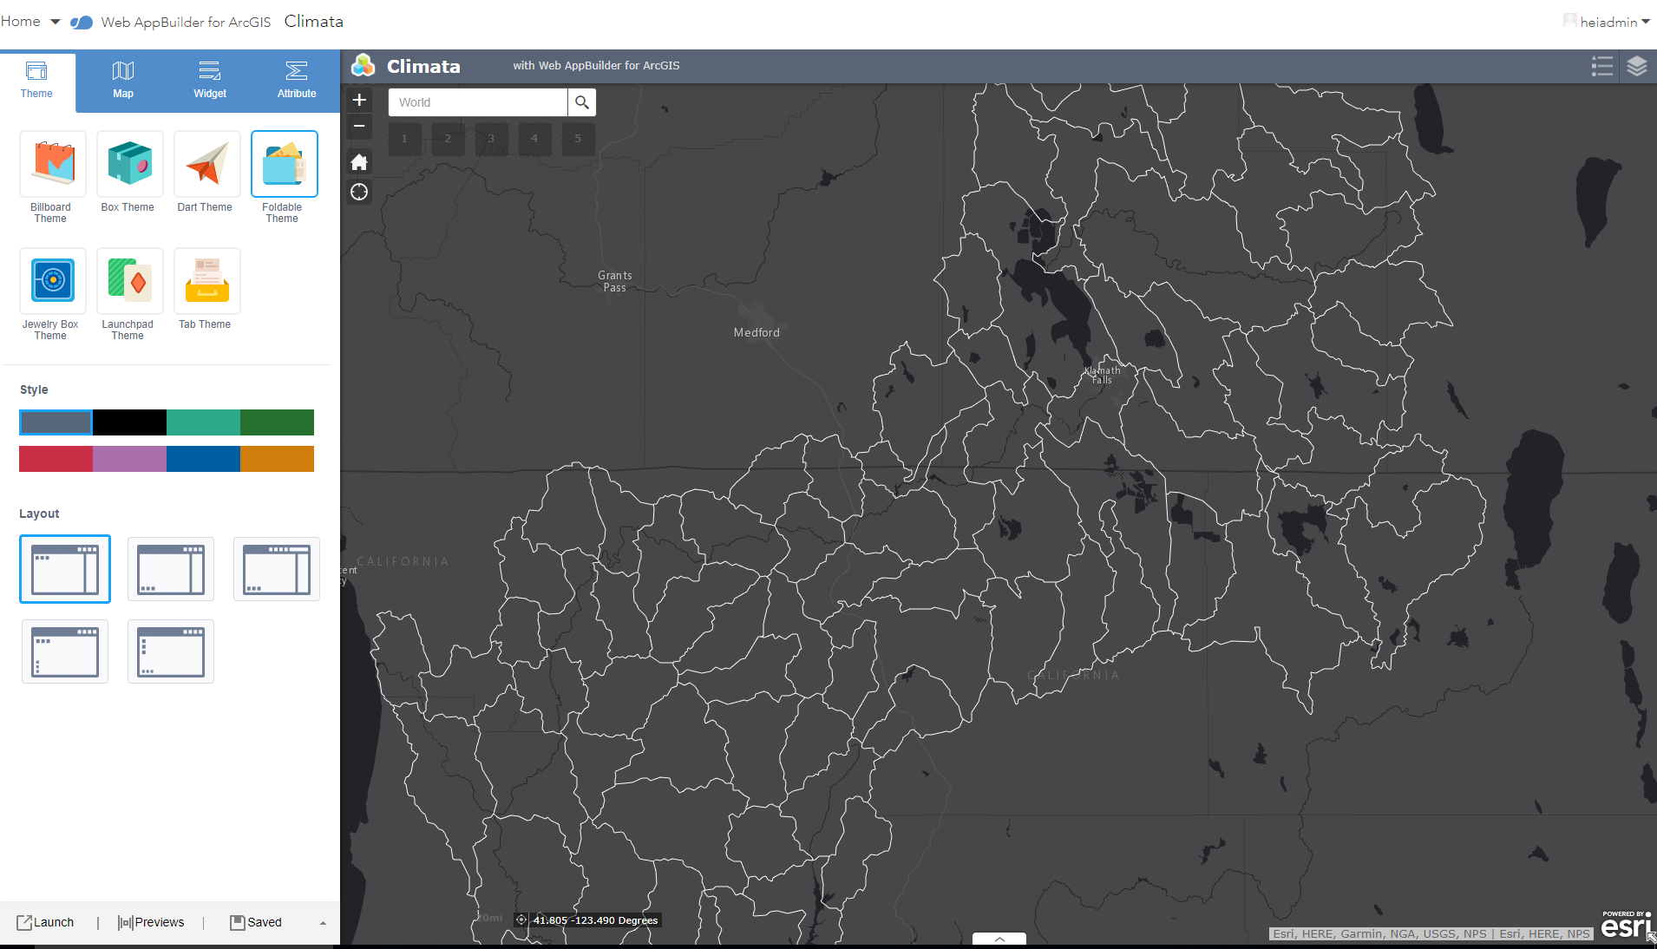
Configure your app. Pick a theme and all out-of-the-box widget you want. Save Note: The step can also be done in the WAB Developer Version

Slide 16
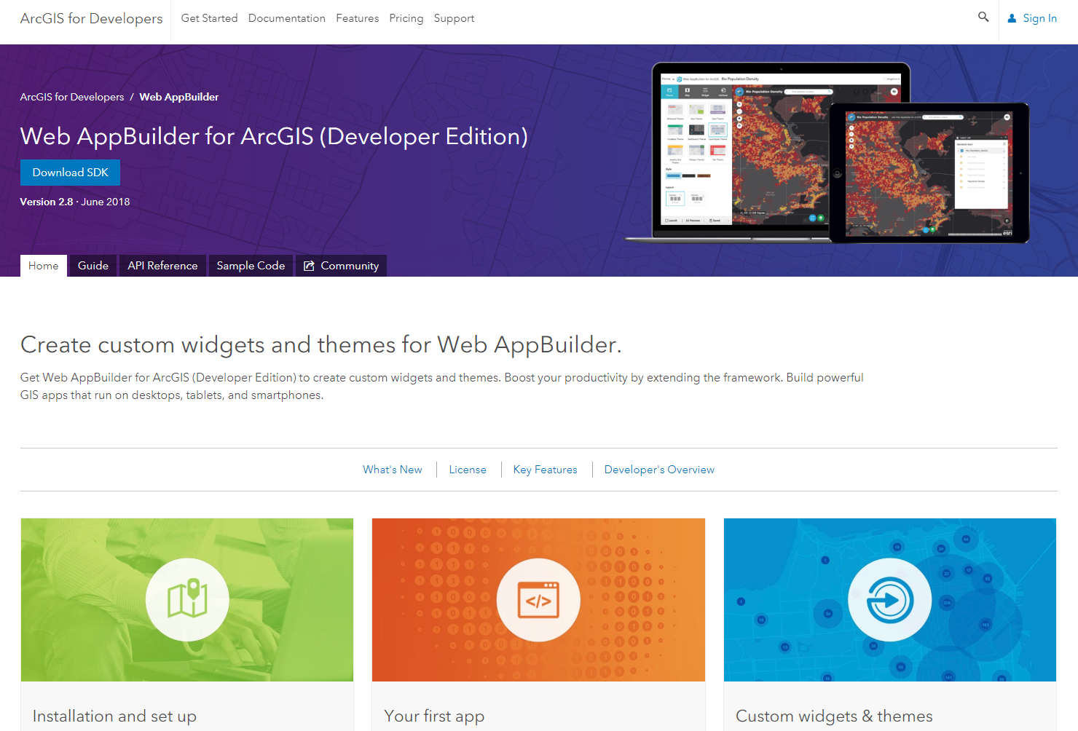
Getting Ready to Roll with the Developers Versions of the WAB……Download the Software

Slide 17
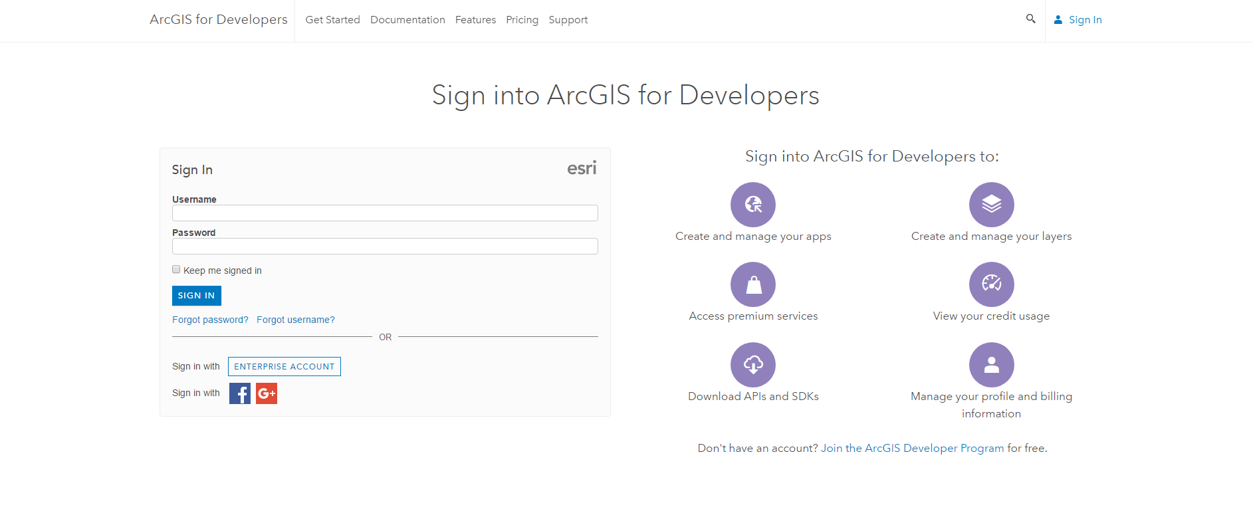
Sign In before you Download

Slide 18
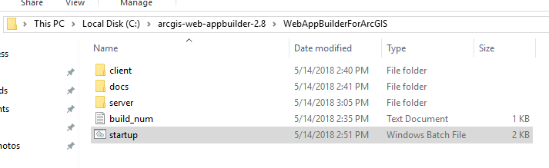
Extract Downloaded Zipfile to Desired Location

Slide 19
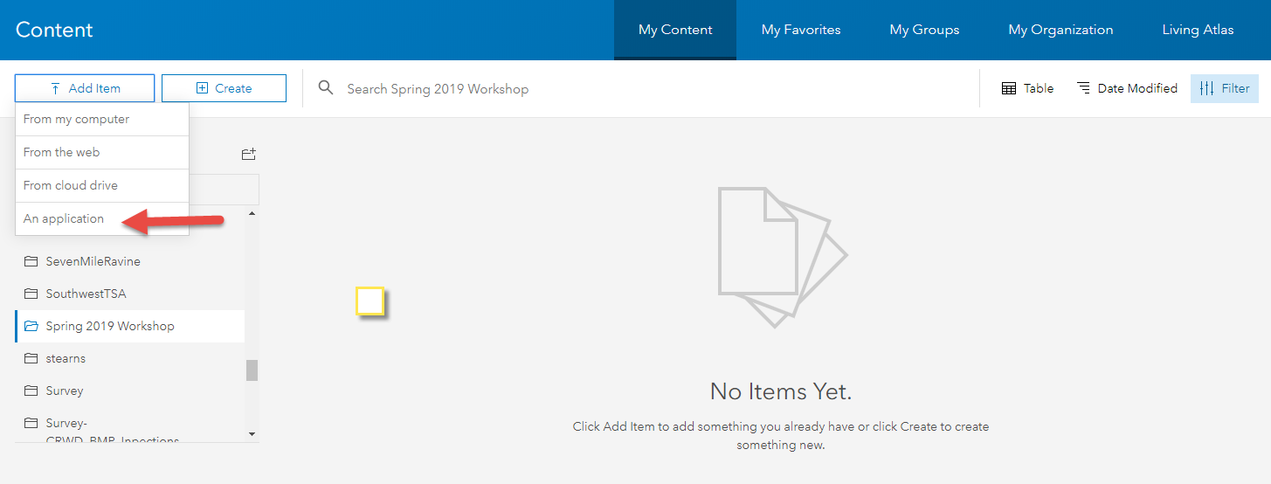
Register WAB Dev Edition w/ AGOL or Portal

Slide 20
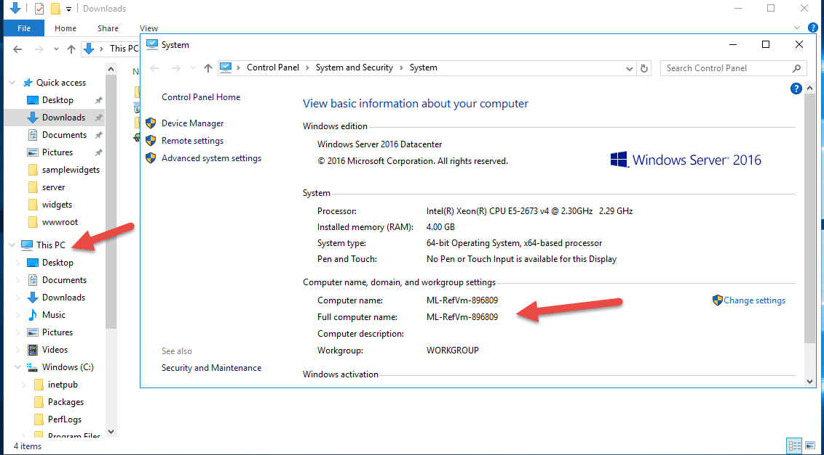
Get the computer name………….

Slide 21
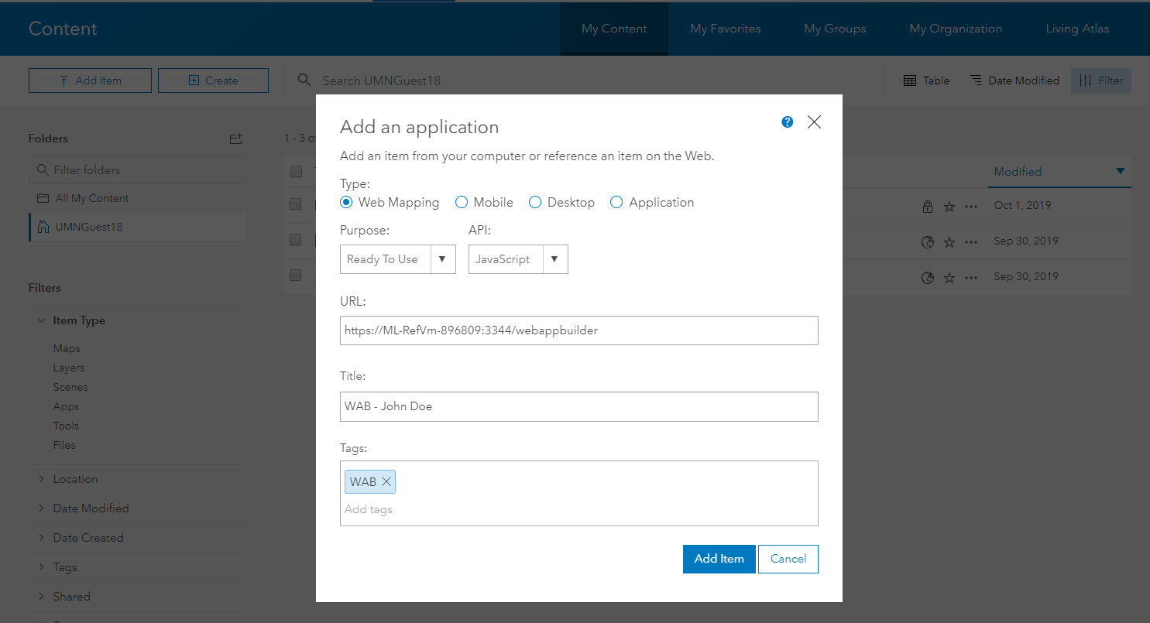
Create Application in AGOL or Portal

Slide 22
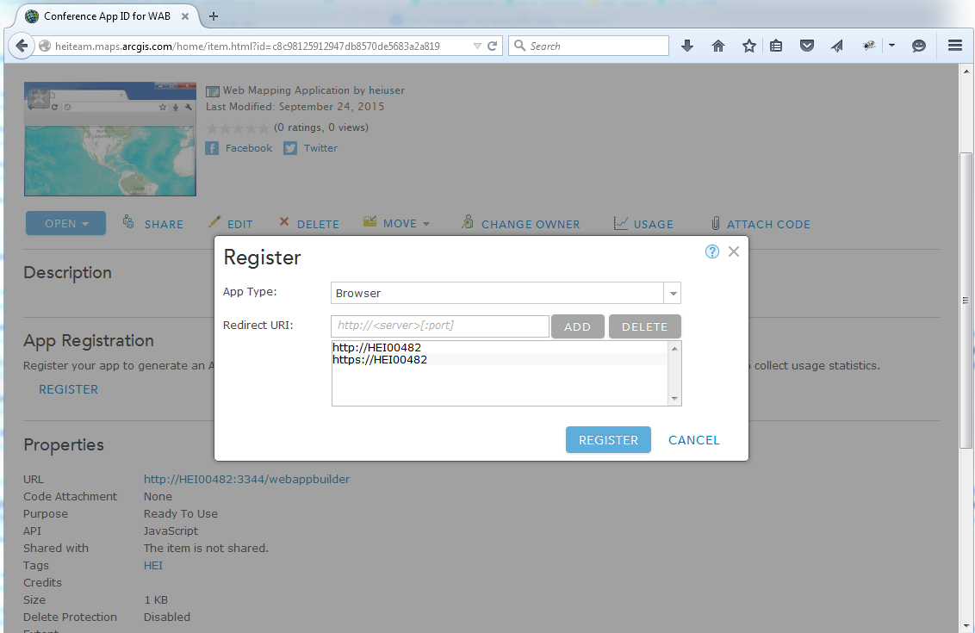

Register Application

Slide 23
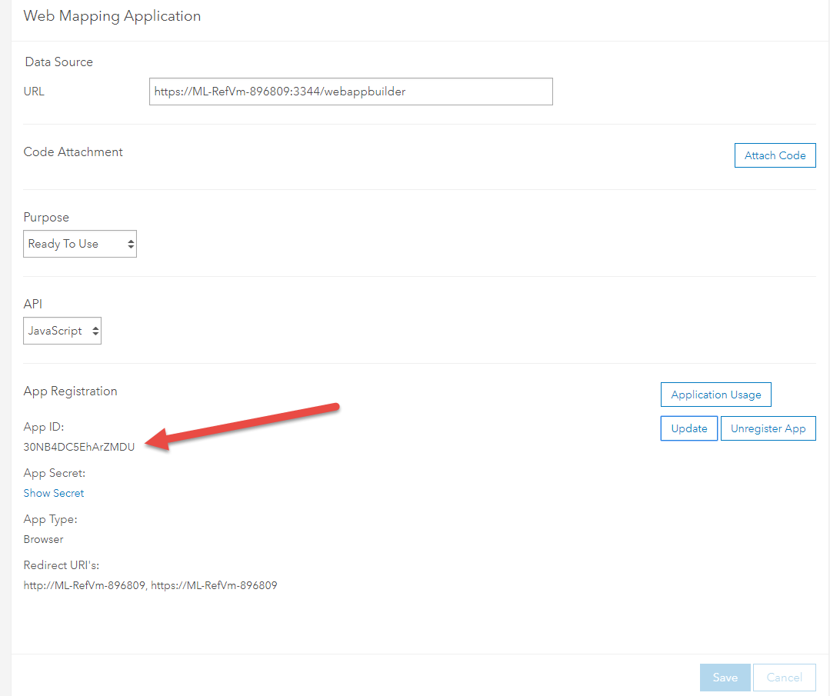
Add AP ID (and Portal URL) to WAB Dev Edition

Slide 24
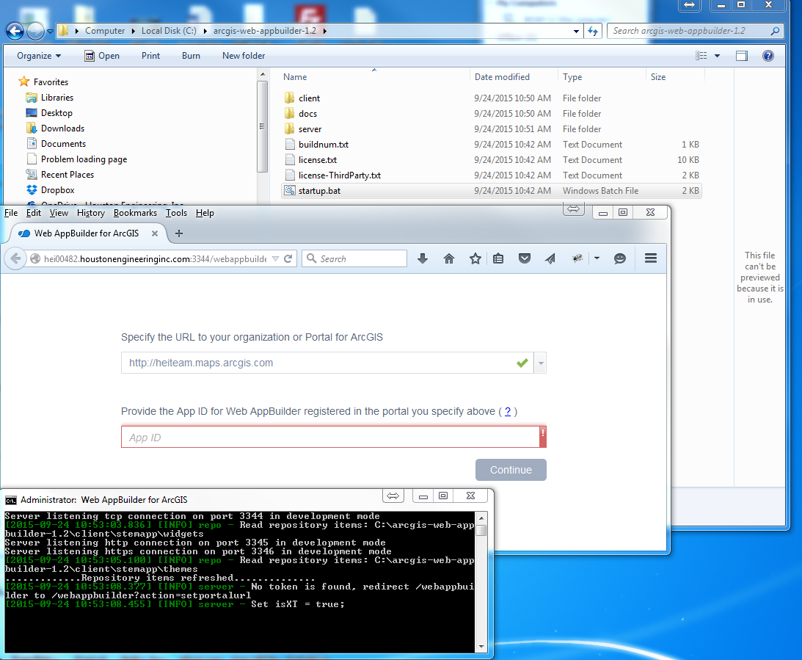
Launch App and add AGOL URL and App ID

Slide 25

Invalid Redirect_URI message……WT????????....No Worries….Not a Big Deal

Slide 26
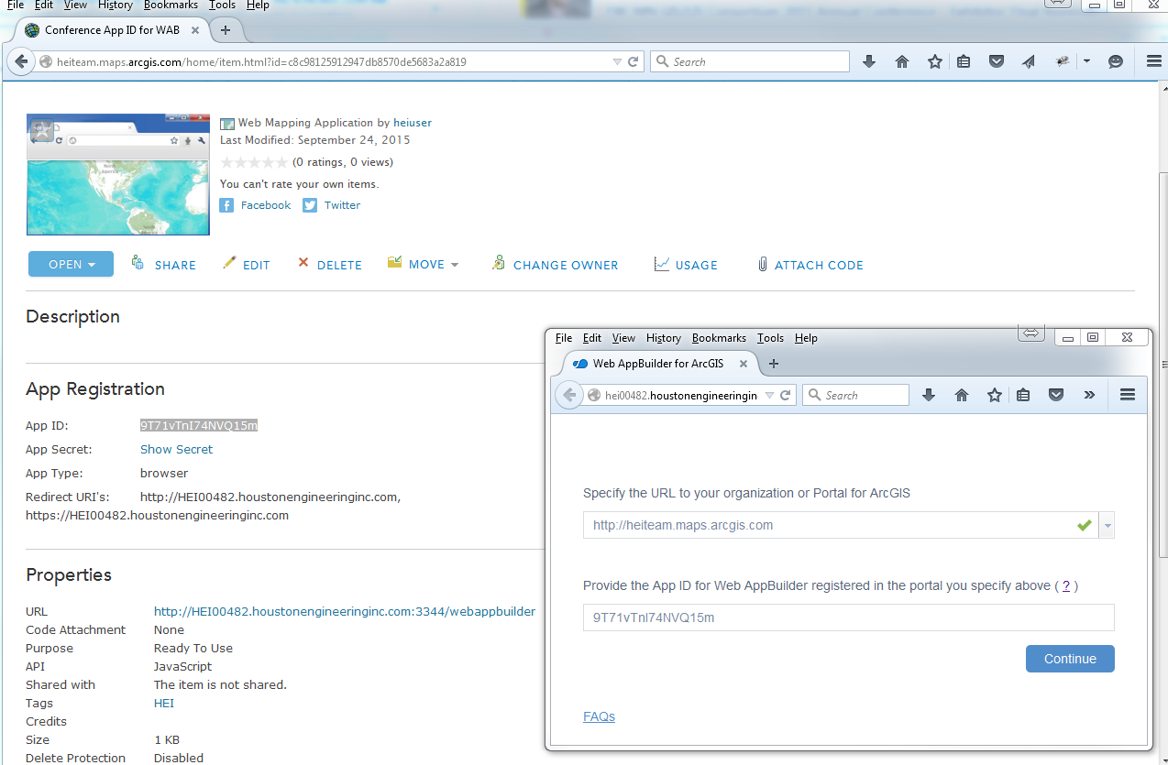
Figure Out Why….In My Case, the full computer name wasn’t used the first go-round. Update App Registration, delete singininfo.json, and try again

Slide 27
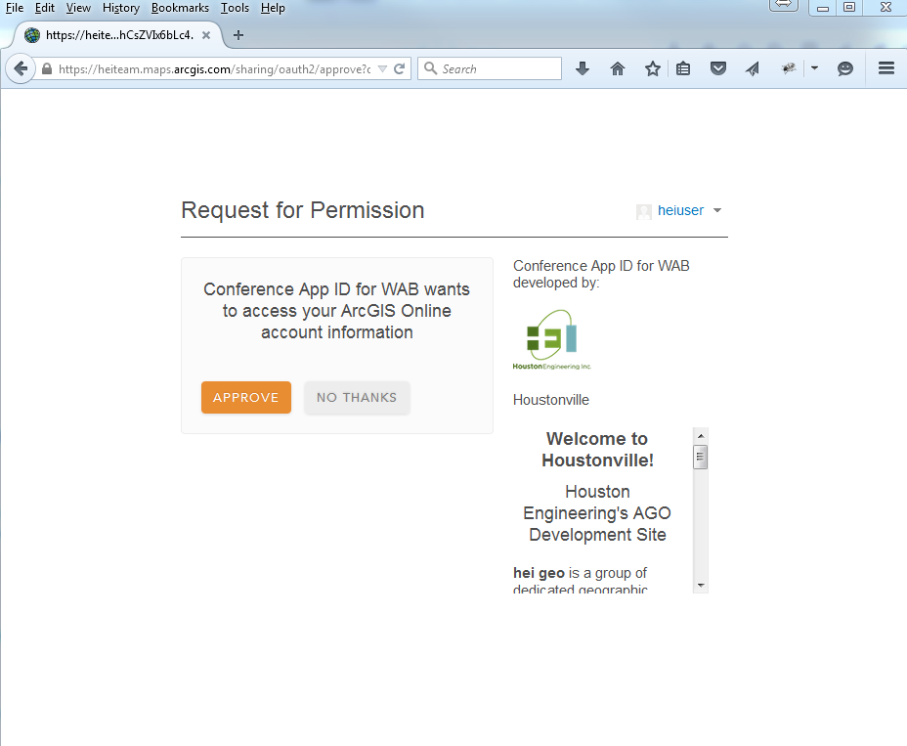
New AppId Worked!!!....Now just give permission

Slide 28
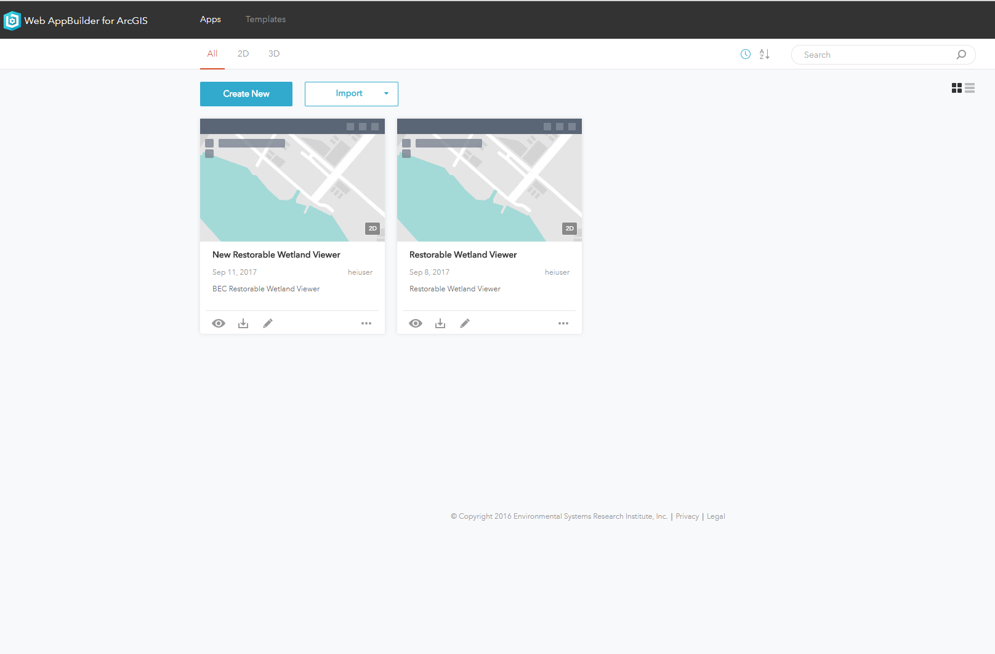
Create New OR Import (Account or Computer)

Slide 29
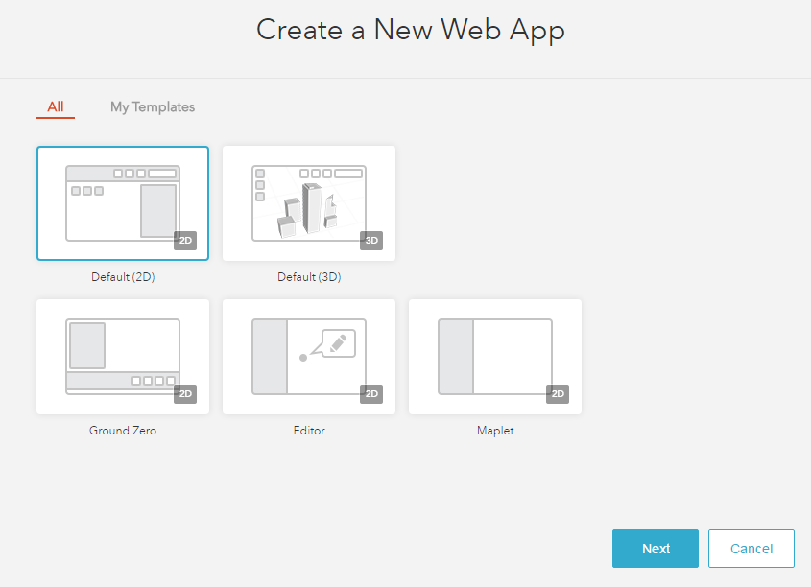
Create New - Select Template

Slide 30
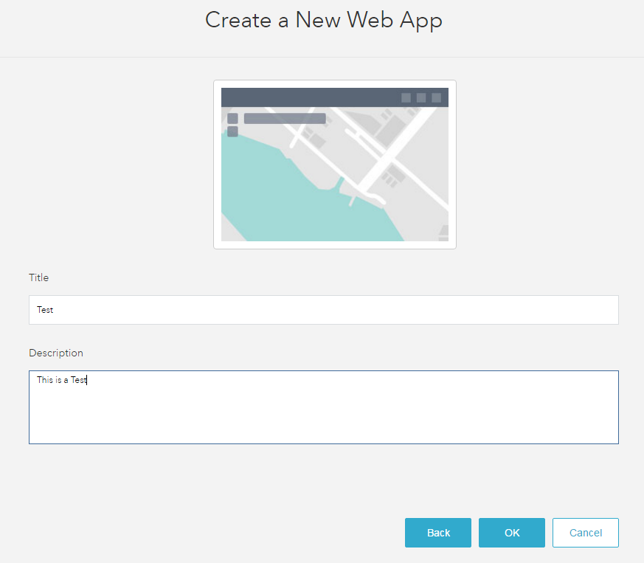
Create New - Give It A Name

Slide 31
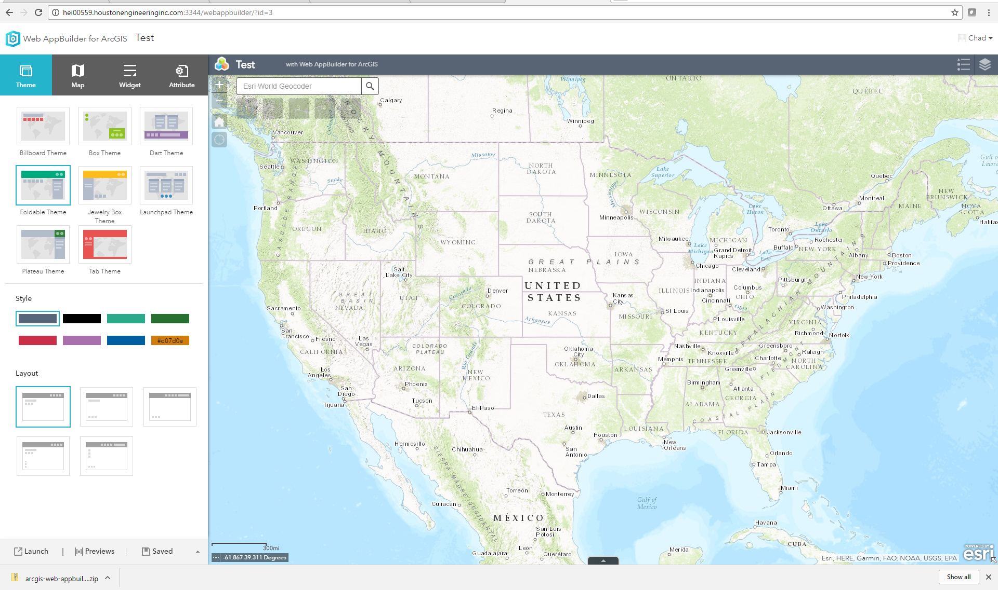
Create and/or configure application with the WAB Developer Edition (Note: Non-custom WAB App configuration can be accomplished via the Developer Edition OR in the AGOL version and then imported)

Slide 32
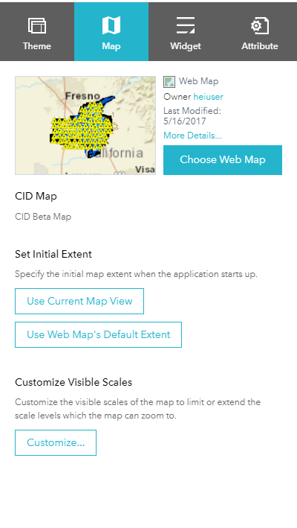
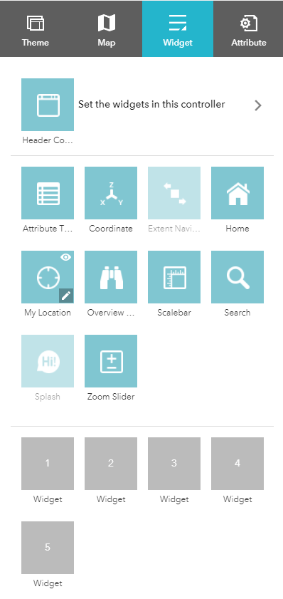
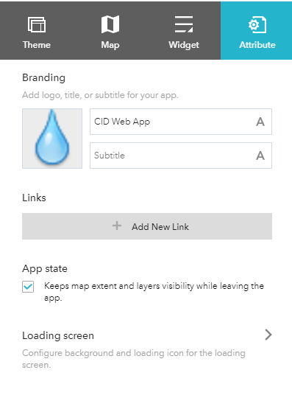
Create and/or configure application with the WAB Developer Edition (Note: Non-custom WAB App configuration can be accomplished via the Developer Edition OR in the AGOL version and then imported)

Slide 33
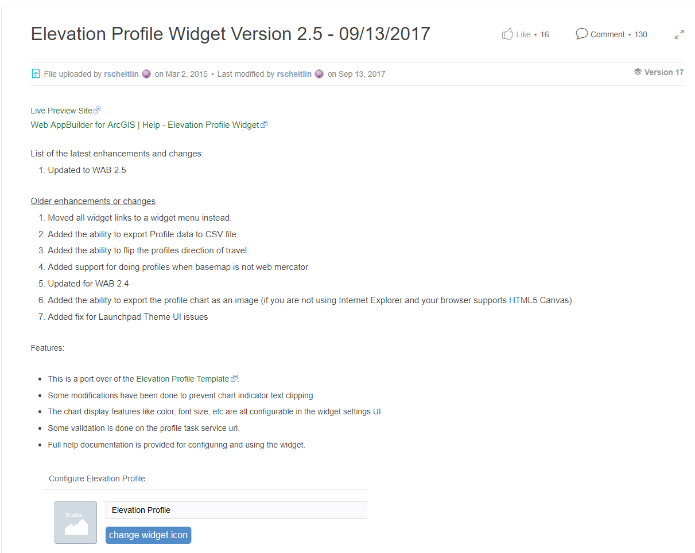
Adding A custom Widget From GitHub or Elsewhere https://community.esri.com/docs/DOC-3342-elevation-profile-widget-version-23-02142017

Slide 34
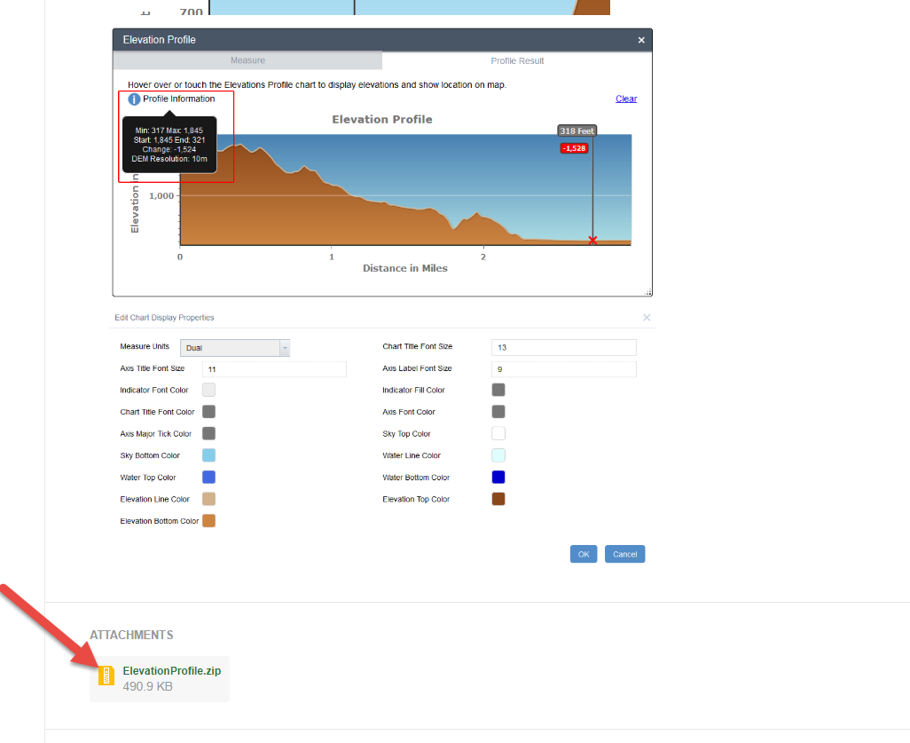
Download It(Make sure you out of the developer version of the WAB and have closed out of the command window as well)

Slide 35
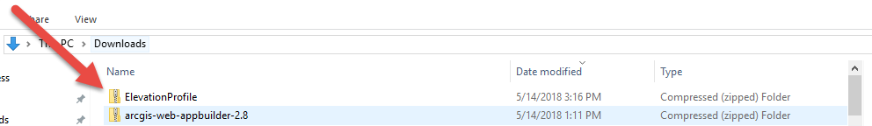
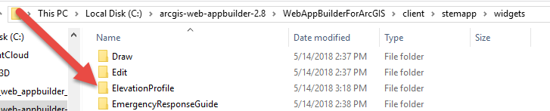
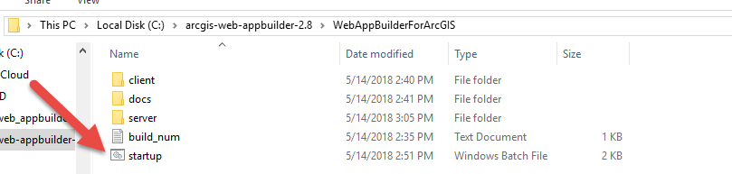
Extract It and Restart It(Make sure you out of the developer version of the WAB and have closed out of the command window as well)

Slide 36
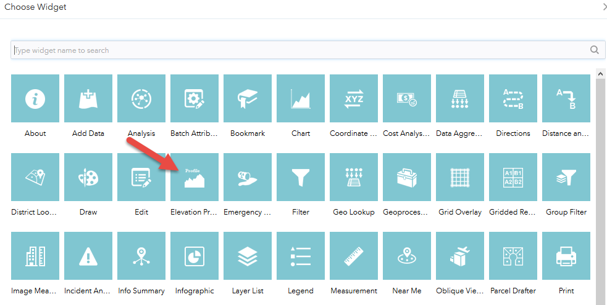
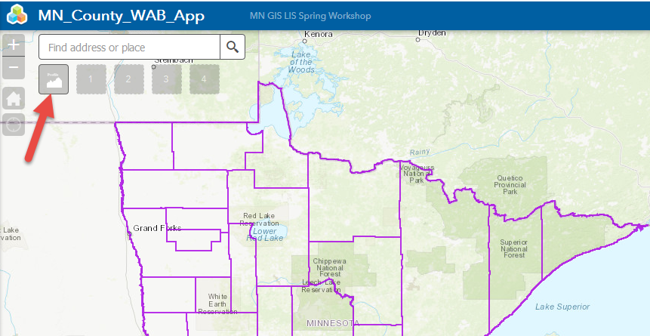
Load it and Use it

Slide 37
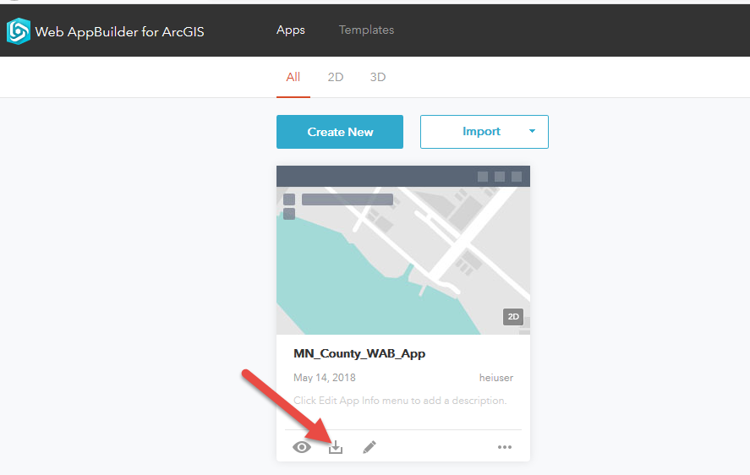
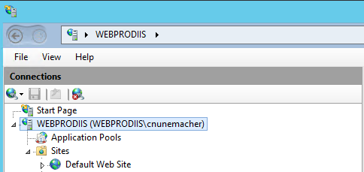
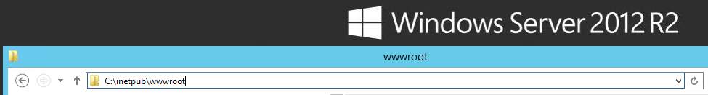
Deployment (Download, Move, and Deploy)

Slide 38
Paul Takes Over

Slide 39

Now On To That Coding Stuff …

Slide 40
Developer Edition – First Steps - Review
Download Developer Edition Files
Start .BAT batch file
Register App ID
Create a new Web Map

Slide 41

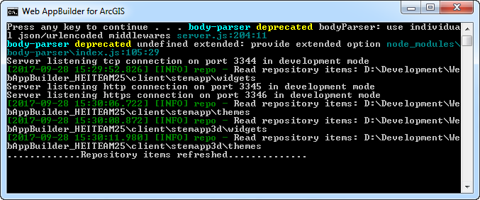
WAB – (Developer Edition) - Overview
Released – Dec. 2014
Leverages ArcGIS API for JavaScript (same back end libraries)
Can add custom widgets and themes
Node.js

Slide 42


WAB Development – Technical Stuff Needed
HTML5/JavaScript/CSS
DOJO Framework
JIMU (Rich SDK) - Chinese for Legos
Configuration in JSON

Slide 43

Let’s Back Track – What is JavaScript???
ECMAScript
ES6 – New version of ECMAScript
jQuery
Dojo
Node.js
React
Angular
Svelte

Slide 44
Wait … What is the ArcGIS JavaScript API ???
ESRI JavaScript library to create custom web maps
For advanced site designing and customizations
Not as many restrictions
Does not require ArcGIS Online or Portal connection
Does not require Web Map and can work directly with services.
Existed before Web AppBuilder framework was created

Slide 45

3.X vs 4.x
Currently all 2D WAB development is on 3.X. All 3D development is done in WAB on 4.X.
Parity between 3.X/4.X JS API versions has been achieved as of 2019
Within a year or two 3.x will be cut off and all support will be on 4.x only.

Slide 46
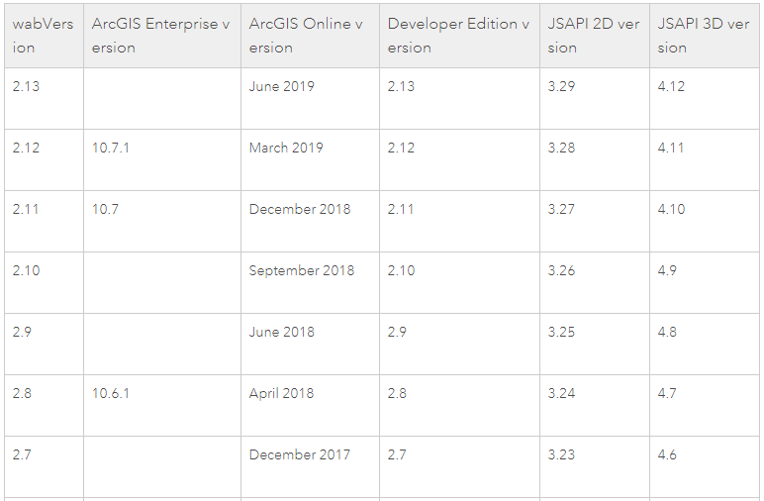
3.X vs 4.x

Slide 47
Widgets
Main use case for developers in Web AppBuilder
50 + widgets available in the default stemapp
Can buy in the ESRI Marketplace
Additional Widgets
Robert Scheitlin:
https://geonet.esri.com/thread/119278-roberts-custom-wab-widgets
Other Sources:
https://github.com/Esri/solutions-webappbuilder-widgets
https://github.com/Esri/WAB-Image-Services-Widgets
https://geonet.esri.com/groups/web-app-builder-custom-widgets
https://web-appbuilder-widget-search.surge.sh/
http://codesharing.arcgis.com/

Slide 48
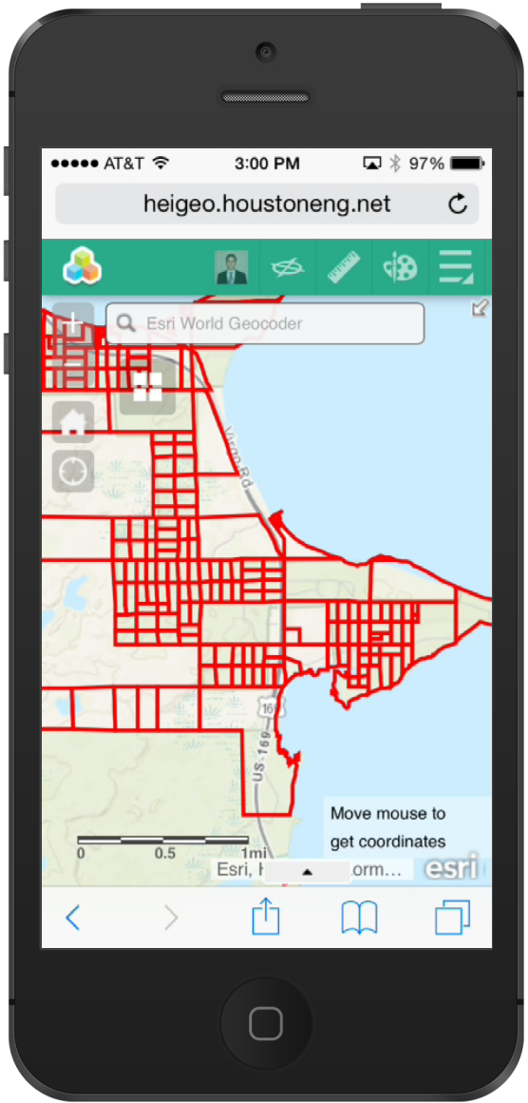
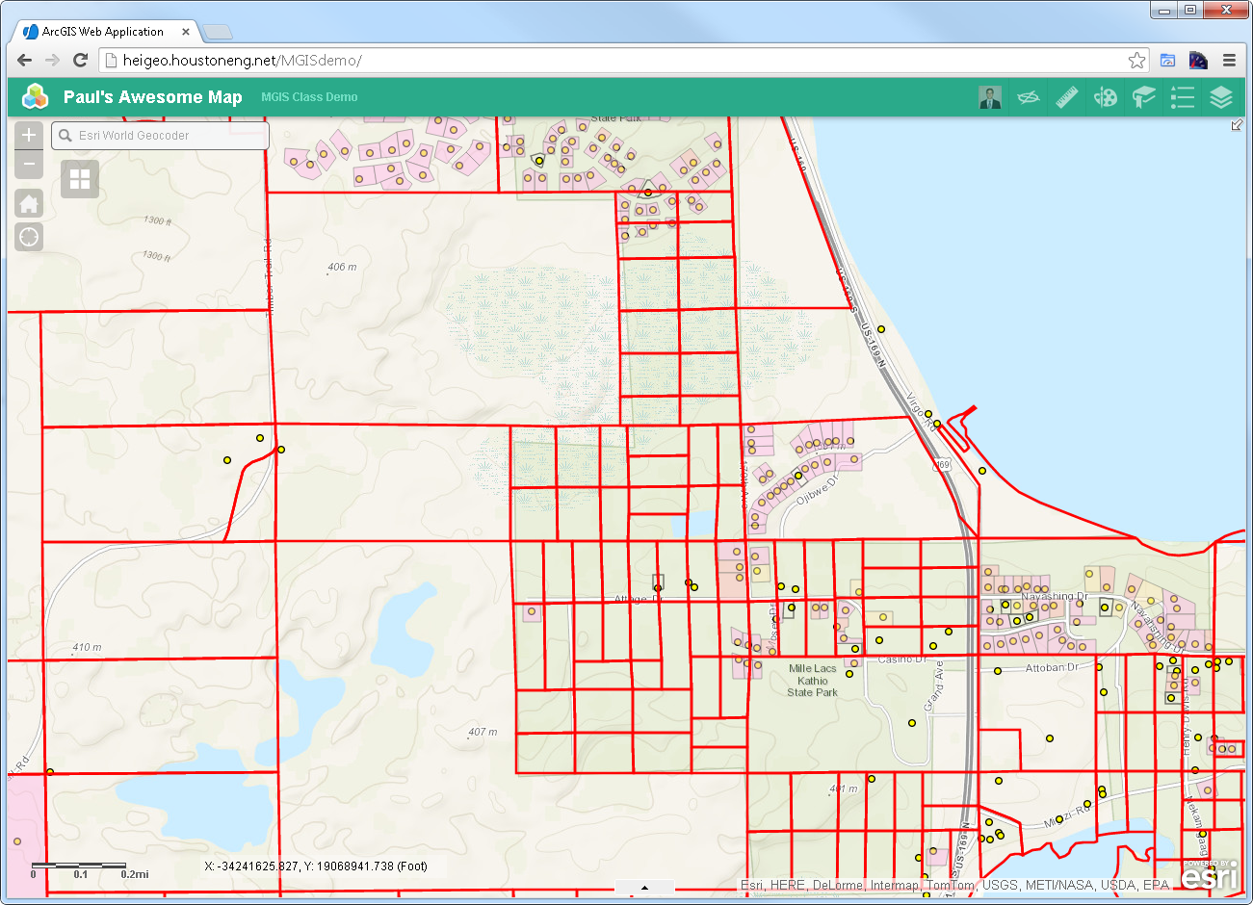
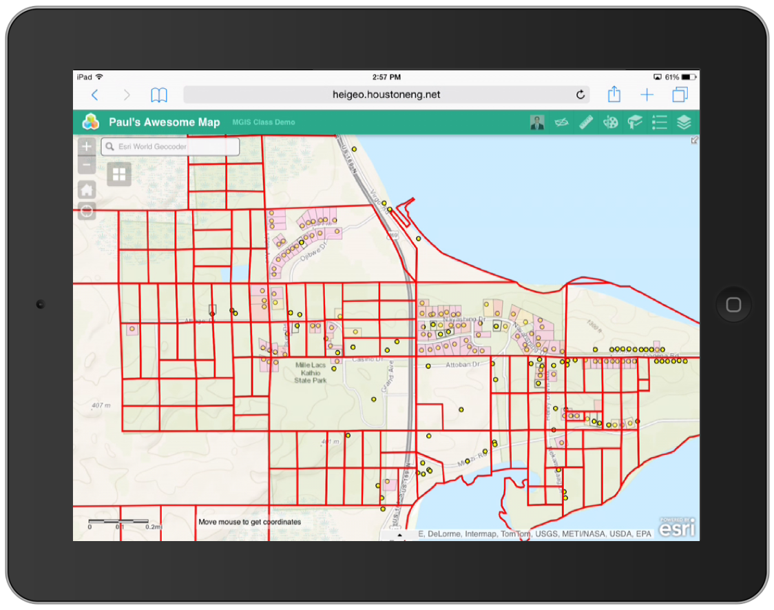
WAB – Responsive Design

Slide 49

WAB - Works on most devices

Slide 50

WAB - Not this one

Slide 51

WAB – Creating Custom Widgets

Slide 52
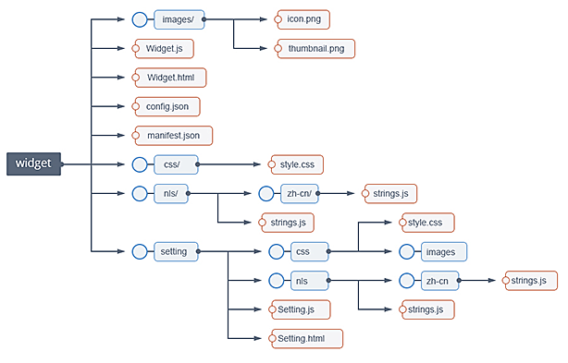
Custom Widget – File Structure
https://github.com/Esri/generator-esri-appbuilder-js

Slide 53
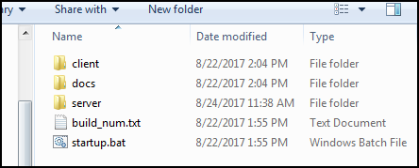
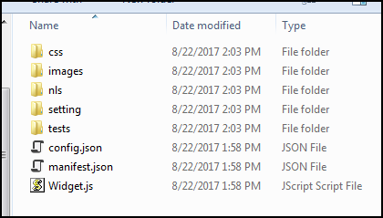
Widget Files …
WebAppBuilder\client\stemapp\widgets\{MyWidget}

Slide 54
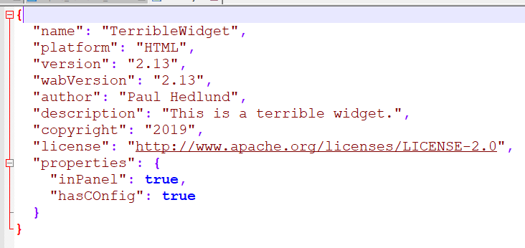
Manifest.json

Slide 55


Custom Widget – Widget.js

Slide 56

WAB – Extend Base Widget

Slide 57

WAB – Custom Widget

Slide 58

WAB – Custom Widget

Slide 59



WAB – Responsive Custom Widget

Slide 60

WAB – Themes
10 out of the box themes

Slide 61
Advanced Tools
Esri-wab-build (https://github.com/gbochenek/esri-wab-build)
Yeoman Framework (organize code)
Gulp/Grunt
TypeScript

Slide 62

Experience Builder
Next evolution of Web AppBuilder
A complete design and code re-write by ESRI
Built on top of 4.X JavaScript API. Also, uses React under the hood.

Slide 63
Experience Builder
Web App Builder = Mobile Friendly
Experience Builder = Mobile First

Slide 64

Experience Builder – Deployment Timeline

Slide 65

Experience Builder – What Does It Look Like?

Slide 66

Experience Builder – What Does It Look Like?

Slide 67
Experience Builder
Beta
https://www.esri.com/en-us/arcgis/products/arcgis-experience-builder/overview
Sample
https://experience.arcgis.com/stemapp/aa3bec379e374bb184b73c25caeb780f

Slide 68
Useful Links
Documentation
http://developers.arcgis.com/web-appbuilder
GeoNet
https://geonet.esri.com/groups/web-app-builder-custom-widgets/content
https://geonet.esri.com/groups/web-appbuilder-custom-themes
Other WAB Resources
https://geonet.esri.com/blogs/myAlaskaGIS/2016/03/09/web-appbuilder-developer-edition-customization-resource-list
https://github.com/gavinr/web-appbuilder-tools-techniques-dev-summit-2018
https://github.com/Esri/generator-esri-appbuilder-js

Slide 69
WAB – Demos – What is Possible
https://egis.umn.edu/twincities/index.html
http://pm.maps.arcgis.com/apps/webappviewer/index.html?id=3eed8d6b30ea443dafe4380d70d0fa5e
http://gisapp.mahoningcountyoh.gov/Mahgis/
https://citymaps.bayswater.wa.gov.au/WABexternal/Census2016/index.html
https://whereto.sg/index.html
http://coolmaps.esri.com/dashboards/visionzero/

Slide 70
A few of the Widgets Developed By HEI
Go Anoka Park App – Advanced Custom Search and Custom Keyword Search
http://gis.anokacountymn.gov/GoAnoka/
Stearns County Park and Rec App - Advanced Custom Search and Custom Keyword Search
https://gis.co.stearns.mn.us/parks/index.html
Sales Tax Rate Map – Minnesota Department of Revenue
https://taxmaps.state.mn.us/salestax/
Others
Mailing Labels Widget
Custom Display Widget for Print (Isolate Widget)
Custom Selection Widget
More

Slide 71

Custom Widget – Time to Code…
https://github.com/paulhedlund/2018GISLIS

Slide 72
Thanks for Attending! Questions?

